Slide 1
From Sequences to Science – Lessons and challenges from 30 years of sequence comparison
William R Pearson
Biochemistry and Molecular Genetics
U. of Virginia
Notes:
Done it a long time (really since the beginnings of sequences)
Requires statistics
The search for homologs is very reliable (we can find the common parts)
Seems to suggest a very very large protein universe
Sometimes we miss things –
Sierk figures
Sequences effective than structures because convenient computational representations miss the details
Today, we care a lot more about function – complex relationship between structure and function
Improved function prediction needs better integration
(NCBI vs Uniprot vs Macie annotations)
We will always miss things.

Slide 2
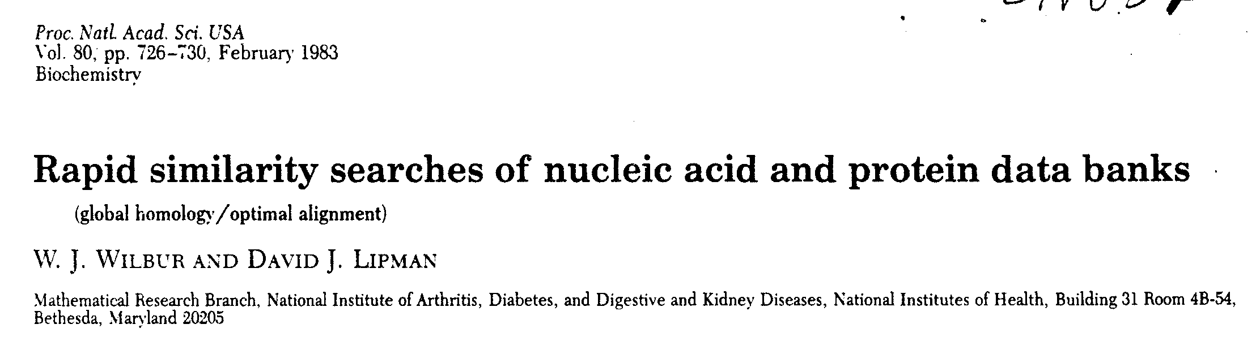
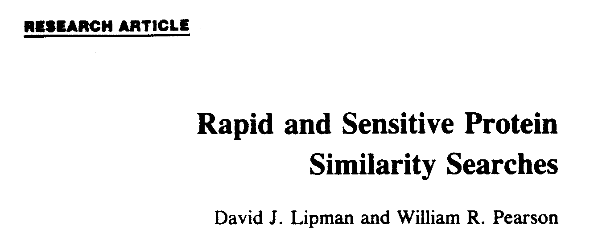
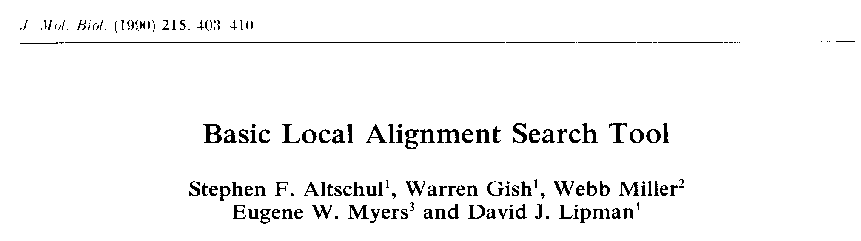
30+ Years of Biological Sequence Comparison
PNAS (1983) 80:726
Science (1985) 227:1435
J. Mol. Biol. (1990) 215:403

Slide 3
30+ years of similarity searching
Lessons – what have we learned?
Darwin was right (we're all related)
life has been complex for a very long time (almost since the beginning!!)
very few constraints on protein sequences
Challenges – what do we miss?
sequence vs structure comparison (sequences still miss homologs)
linking structure to function
what does it do?
when does it break?

Slide 4
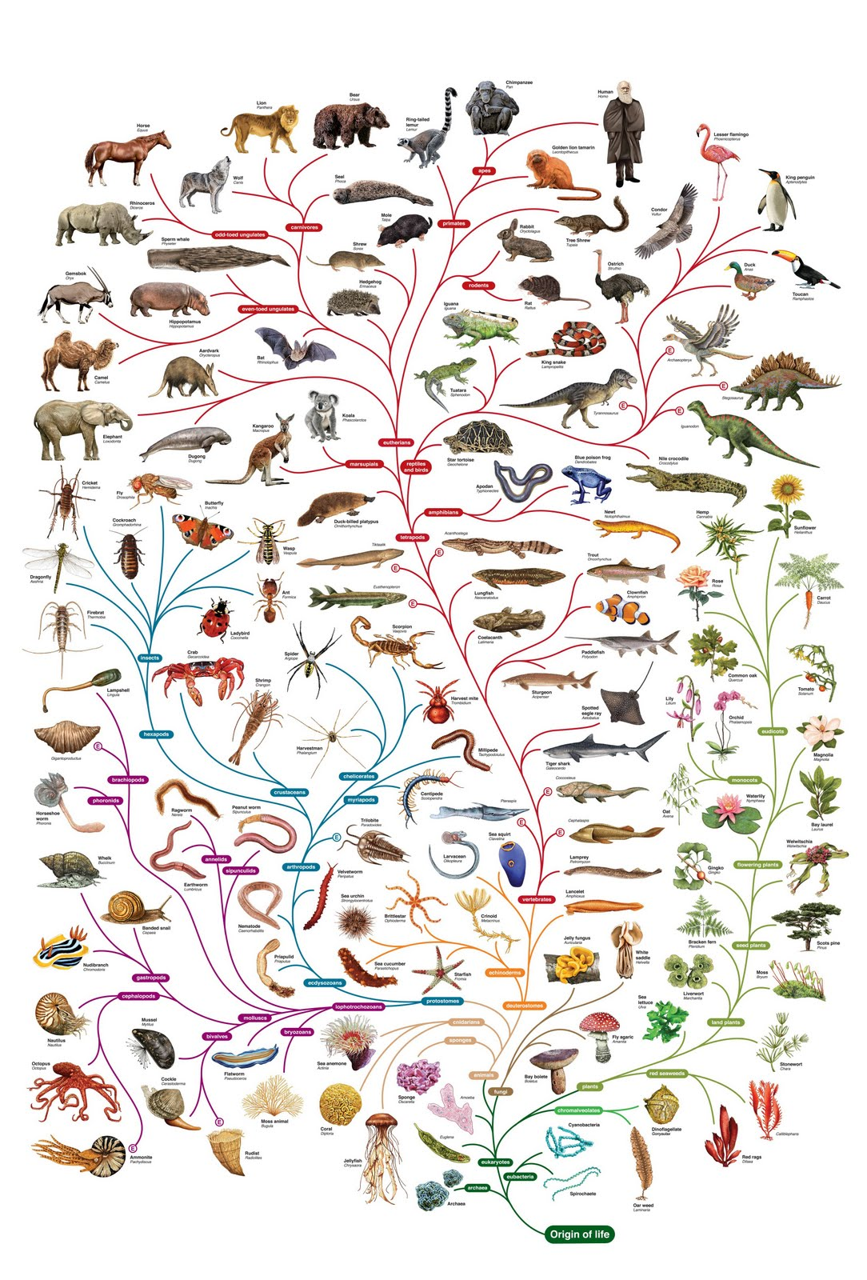
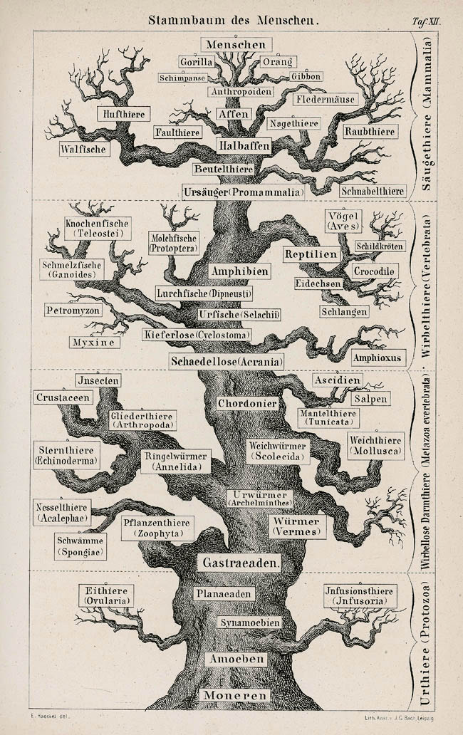
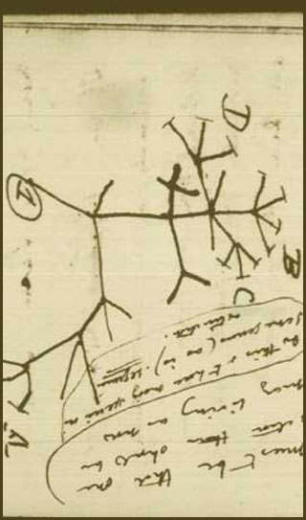
Darwin was right (sequences share common ancestors)

Slide 5
E. coli proteins vs Human – Ancient Proteins
+----------+------+------+---------------------------+---------------------------+------------+
| expect | %_id | alen | E coli descr | Human descr | sp_name |
+----------+------+------+---------------------------+---------------------------+------------+
| 2.7e-206 | 53.8 | 944 | glycine decarboxylase, P | Glycine dehydrogenase [de | GCSP_HUMAN |
| 1.2e-176 | 59.5 | 706 | methylmalonyl-CoA mutase | Methylmalonyl-CoA mutase, | MUTA_HUMAN |
| 3.8e-176 | 50.6 | 803 | glycogen phosphorylase [E | Glycogen phosphorylase, l | PHS1_HUMAN |
| 9.9e-173 | 55.6 | 1222 | B12-dependent homocystein | 5-methyltetrahydrofolate- | METH_HUMAN |
| 1.8e-165 | 41.8 | 1031 | carbamoyl-phosphate synth | Carbamoyl-phosphate synth | CPSM_HUMAN |
| 5.6e-159 | 65.7 | 542 | glucosephosphate isomeras | Glucose-6-phosphate isome | G6PI_HUMAN |
| 8.1e-143 | 53.7 | 855 | aconitate hydrase 1 [Esch | Iron-responsive element b | IRE1_HUMAN |
| 2.5e-134 | 73.0 | 459 | membrane-bound ATP syntha | ATP synthase beta chain, | ATPB_HUMAN |
| 3.3e-121 | 55.8 | 550 | succinate dehydrogenase, | Succinate dehydrogenase [ | DHSA_HUMAN |
| 1.5e-113 | 60.6 | 401 | putative aminotransferase | Cysteine desulfurase, mit | NFS1_HUMAN |
| 4.4e-111 | 60.9 | 460 | fumarase C= fumarate hydr | Fumarate hydratase, mitoc | FUMH_HUMAN |
| 1.5e-109 | 56.1 | 474 | succinate-semialdehyde de | Succinate semialdehyde de | SSDH_HUMAN |
| 3.6e-106 | 44.7 | 789 | maltodextrin phosphorylas | Glycogen phosphorylase, m | PHS2_HUMAN |
| 1.4e-102 | 53.1 | 484 | NAD+-dependent betaine al | Aldehyde dehydrogenase, E | DHAG_HUMAN |
| 3.8e-98 | 53.0 | 449 | pyridine nucleotide trans | NAD(P) transhydrogenase, | NNTM_HUMAN |
| 5.8e-96 | 49.9 | 489 | glycerol kinase [Escheric | Glycerol kinase, testis s | GKP2_HUMAN |
| 2.1e-95 | 66.8 | 328 | glyceraldehyde-3-phosphat | Glyceraldehyde 3-phosphat | G3P2_HUMAN |
| 5.0e-91 | 62.5 | 368 | alcohol dehydrogenase cla | Alcohol dehydrogenase cla | ADHX_HUMAN |
| 6.7e-91 | 56.5 | 393 | protein chain elongation | Elongation factor Tu, mit | EFTU_HUMAN |
| 9.5e-91 | 56.6 | 392 | protein chain elongation | Elongation factor Tu, mit | EFTU_HUMAN |
| 2.2e-89 | 59.1 | 369 | methionine adenosyltransf | S-adenosylmethionine synt | METK_HUMAN |
| 6.5e-88 | 53.3 | 422 | enolase [Escherichia coli | Alpha enolase (2-phospho- | ENOA_HUMAN |
| 9.2e-88 | 43.3 | 536 | NAD-linked malate dehydro | NADP-dependent malic enzy | MAOX_HUMAN |
| 7.3e-86 | 55.5 | 389 | 2-amino-3-ketobutyrate Co | 2-amino-3-ketobutyrate co | KBL_HUMAN |
| 5.2e-83 | 44.4 | 543 | degrades sigma32, integra | AFG3-like protein 2 (Para | AF32_HUMAN |
+----------+------+------+---------------------------+---------------------------+------------+
Science (1993) 259:1711

Slide 6
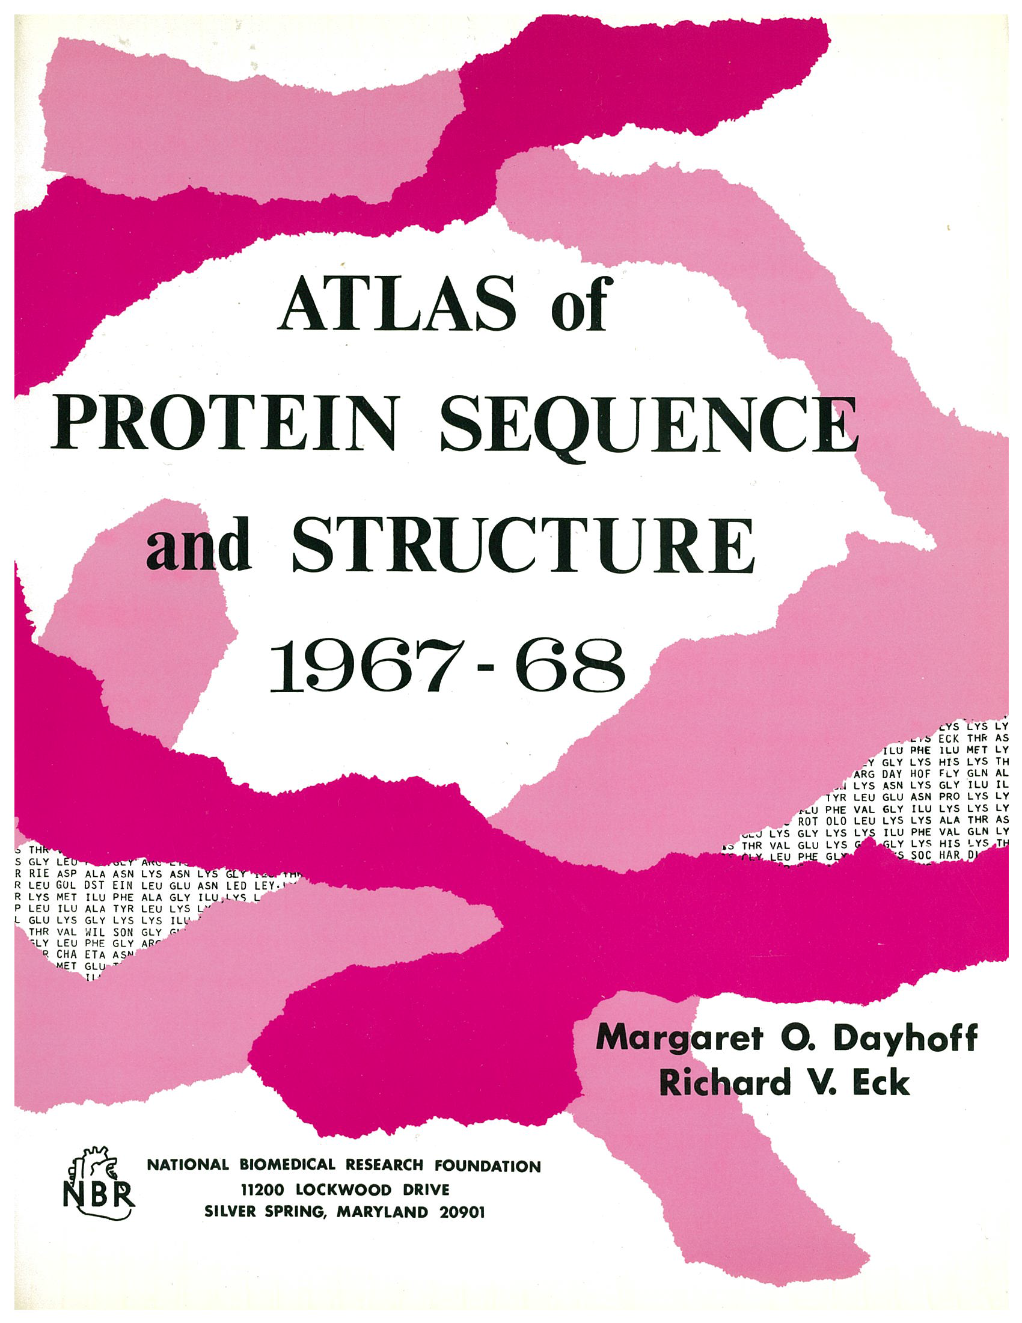
Homologous proteins share a common ancestor
human
insect
worm
wheat
yeast
E. coli
horse
fish
-0.1
vertebrates/
arthopods
18,000
6,530
4,289
-1.0
plants/animals
time (bilions of years)
-2.0
prokaryotes/eukaryotes
-3.0
self-replicating systems
-4.0
chemical evolution

Slide 7
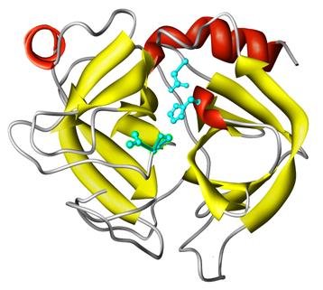
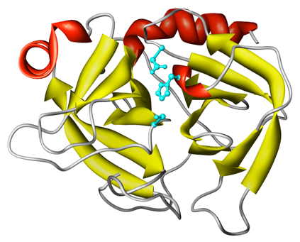
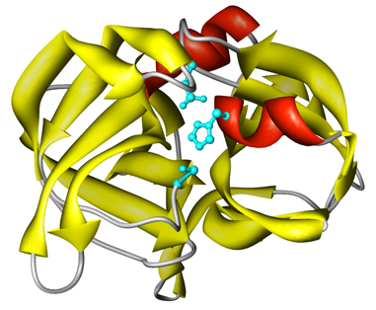
Identifying the parts - homology
Homology => structural similarity
? sequence similarity
Bovine trypsin (5ptp)
Structure: E()< 10⁻²³;
RMSD 0.0 A
Sequence: E()< 10⁻⁸⁴
100% 223/223
S. griseus trypsin (1sgt)
E()< 10⁻¹⁴ RMSD 1.6 A
E()< 10⁻¹⁹ 36%; 226/223
S. griseus protease A (2sga)
E()< 10⁻⁴; RMSD 2.6 A
E()< 2.6 25%; 199/181
Notes:
We believe that homologous sequences share a common ancestor because they have very similar tertiary structures. When we only have sequence data, we infer homology based on statistically significant similarity. However, distantly related homologues often lack statistically significant similarity. Thus similarity can be used to infer homology, but not to infer non-homology.

Slide 8
Inferring Homology from Statistical Significance
Real UNRELATED sequences have similarity scores that are indistinguishable from RANDOM sequences
If a similarity is NOT RANDOM, then it must be NOT UNRELATED
Therefore, NOT RANDOM (statistically significant) similarity must reflect RELATED sequences
With 20+ million protein sequences, it is easy to explore what can happen by chance

Slide 9
Homology inferences are reliable because similarity statistics are accurate
10000
8000
6000
Number of Sequences
4000
2000
0
Z(σ)
-
2
0
2
4
6
Similarity Score
Pairwise similarity statistics are accurate because protein sequences are random

Slide 10
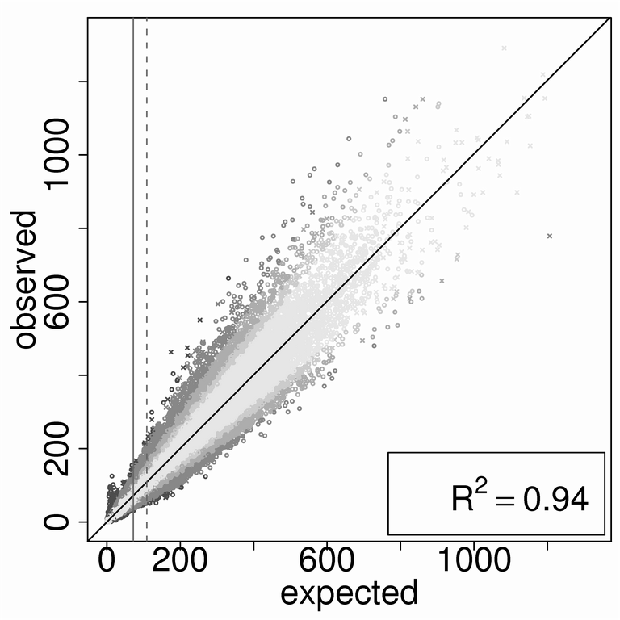
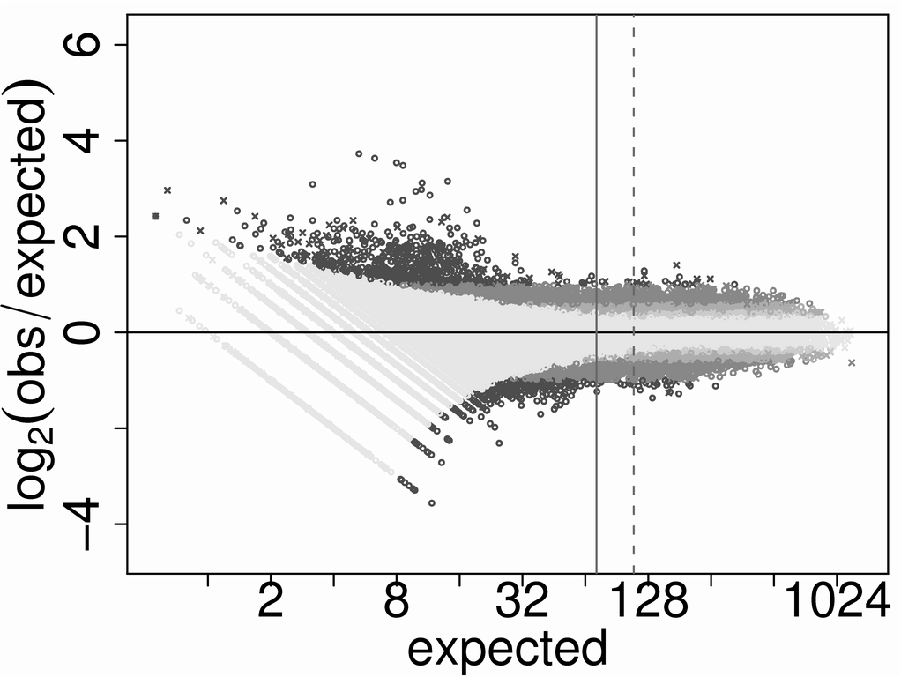
If protein sequences are random – Are there constraints on sequences?
Random? Yes
Constrained? No
Lavelle and Pearson, 2010

Slide 11
“All science is either physics or stamp collecting.” –Ernest Rutherford
“If your experiment needs statistics, you ought to have done a better experiment.”

Slide 12
It is a safe rule to apply that, when a mathematical or philosophical author writes with a misty profundity, he is talking nonsense. – Alfred North Whitehead, An Introduction to Mathematics, 1948

Slide 13
30+ years of similarity searching
Lessons – what have we learned?
Darwin was right (we're all related)
life has been complex for a very long time (almost since the beginning!!)
very few constraints on protein sequences
Challenges – what do we miss?
sequence vs structure comparison (sequences still miss homologs)
linking structure to function
what does it do?
when does it break?

Slide 14
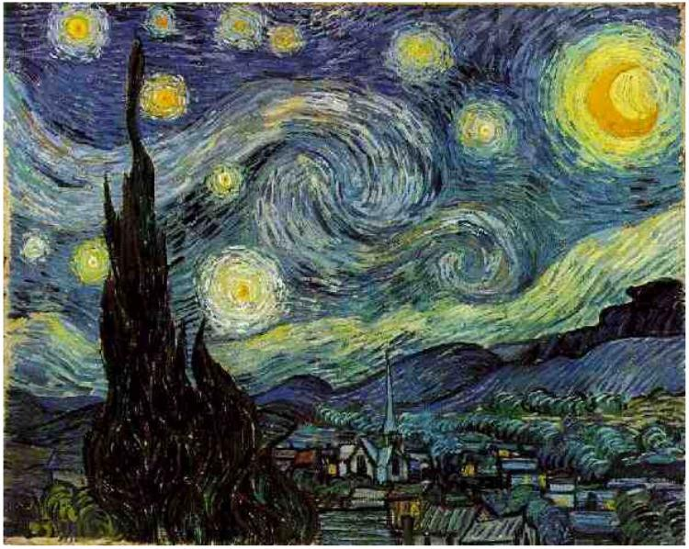
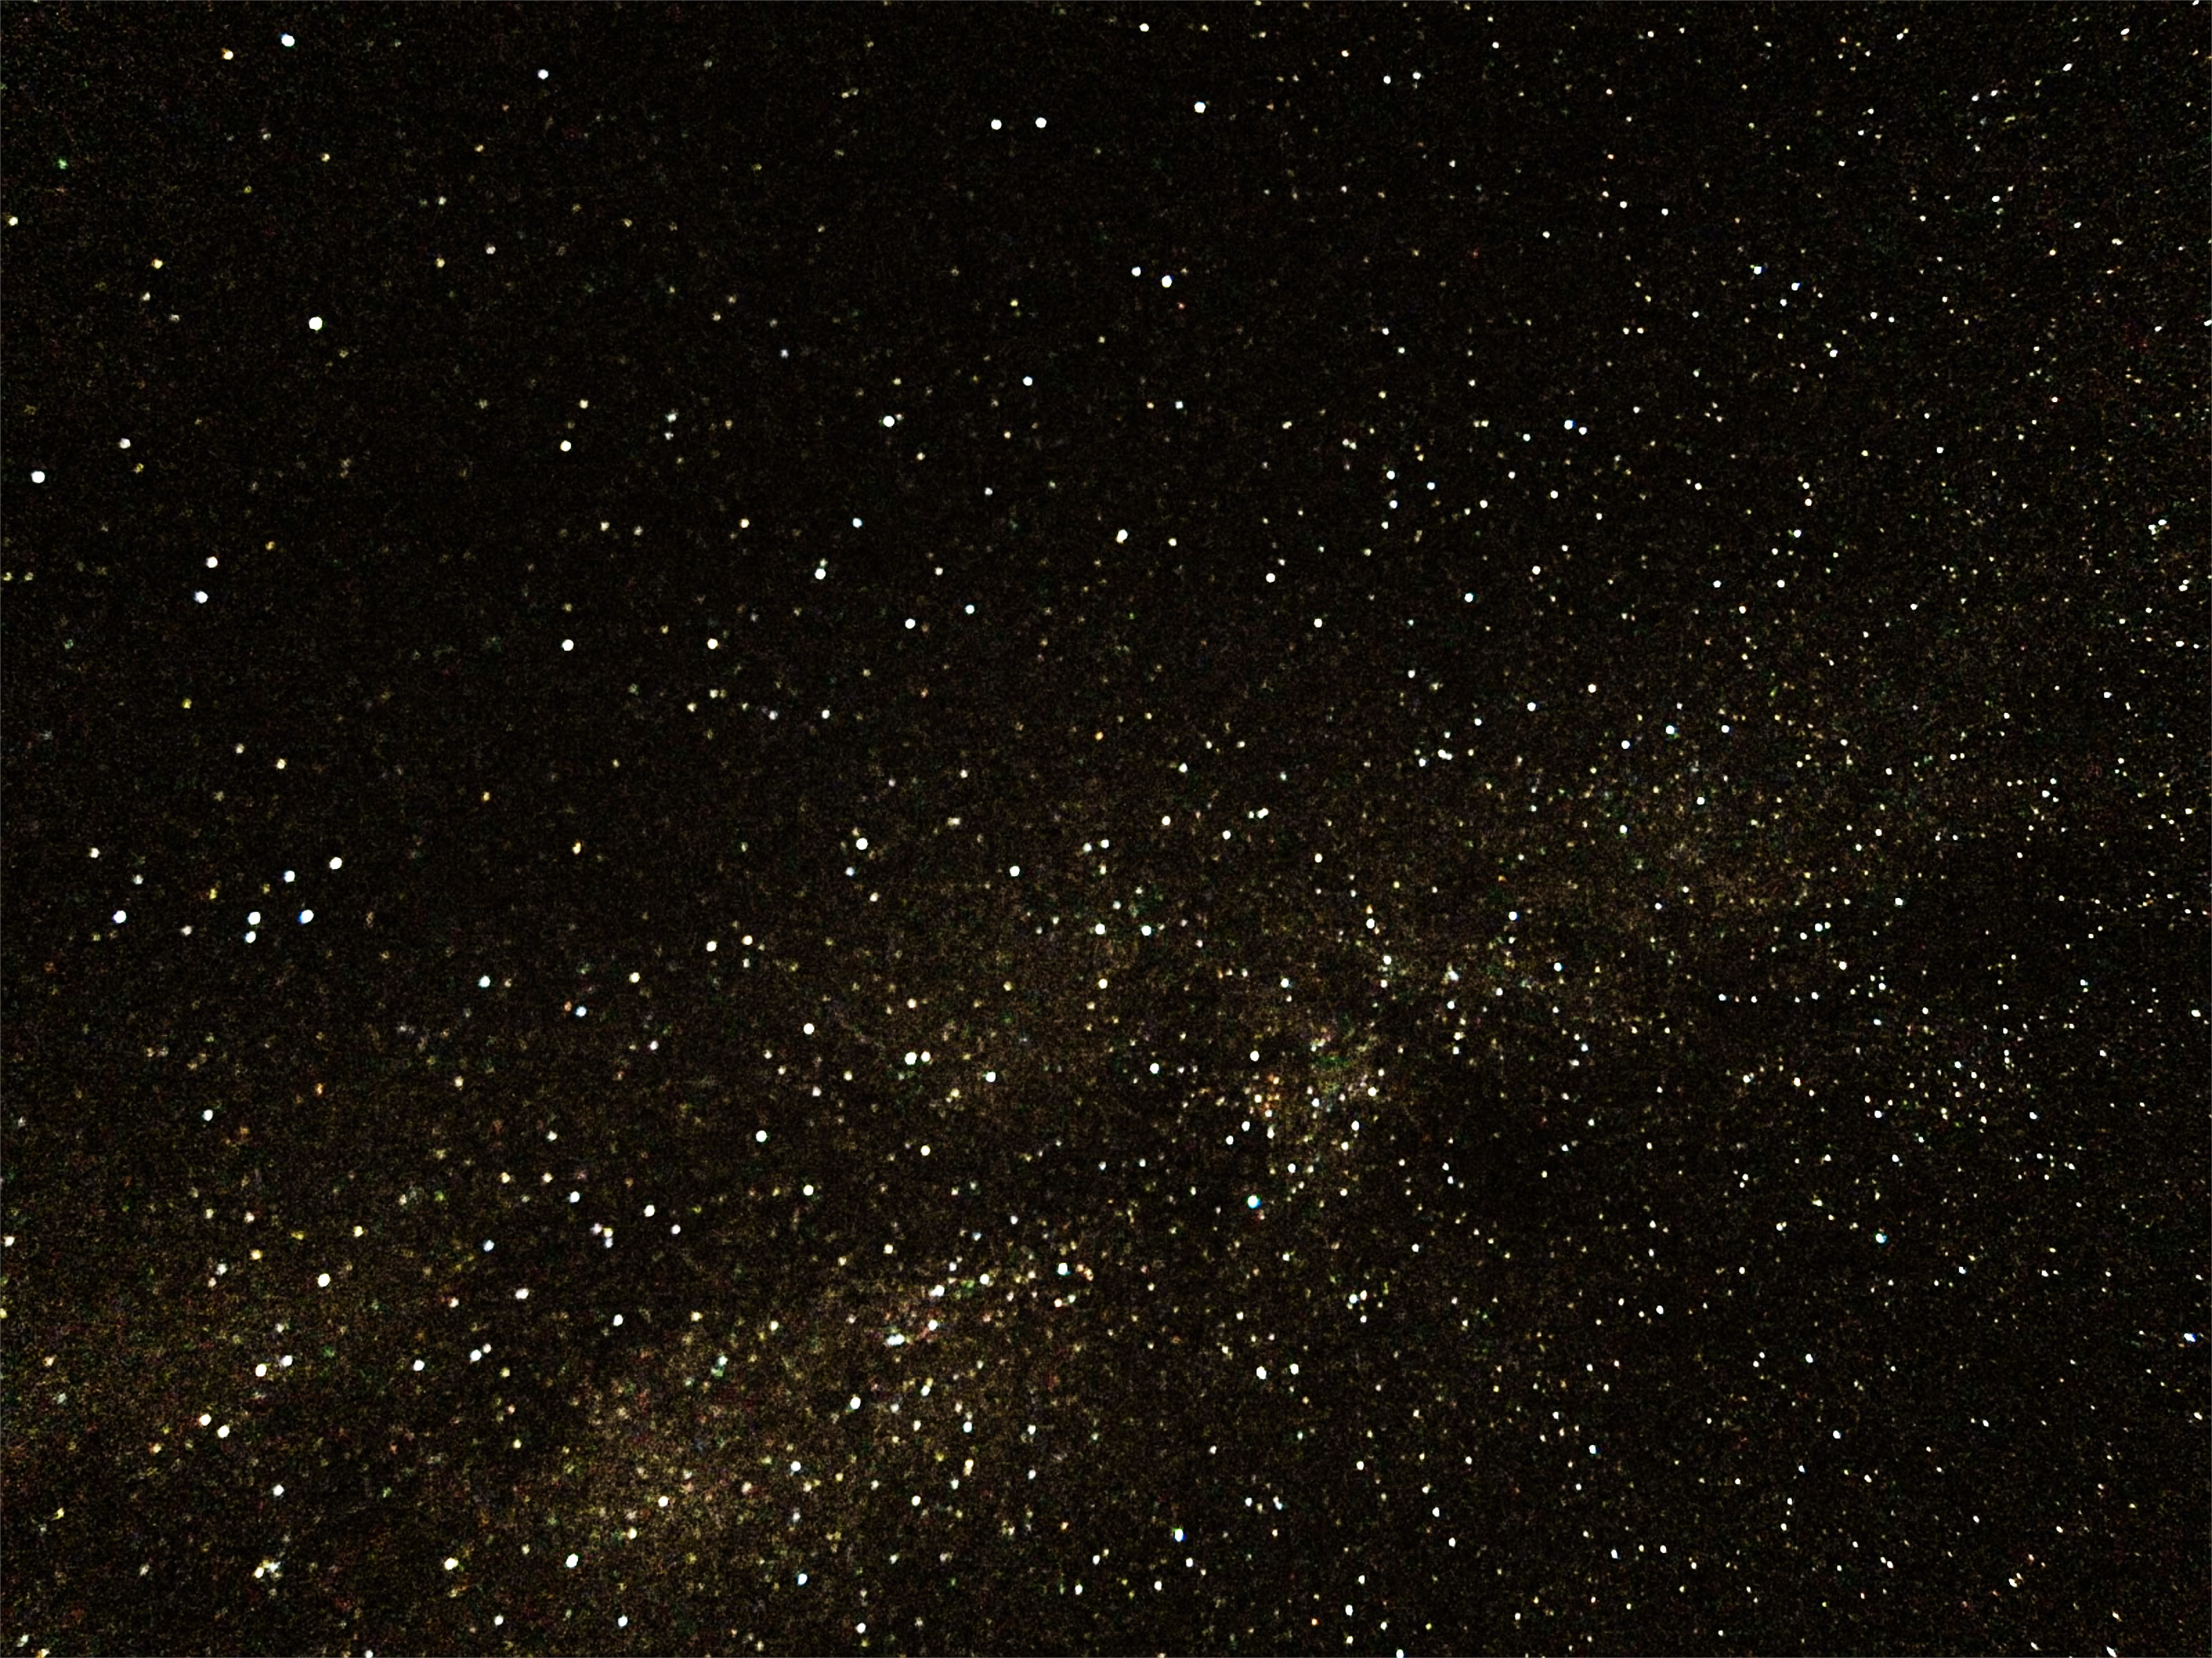
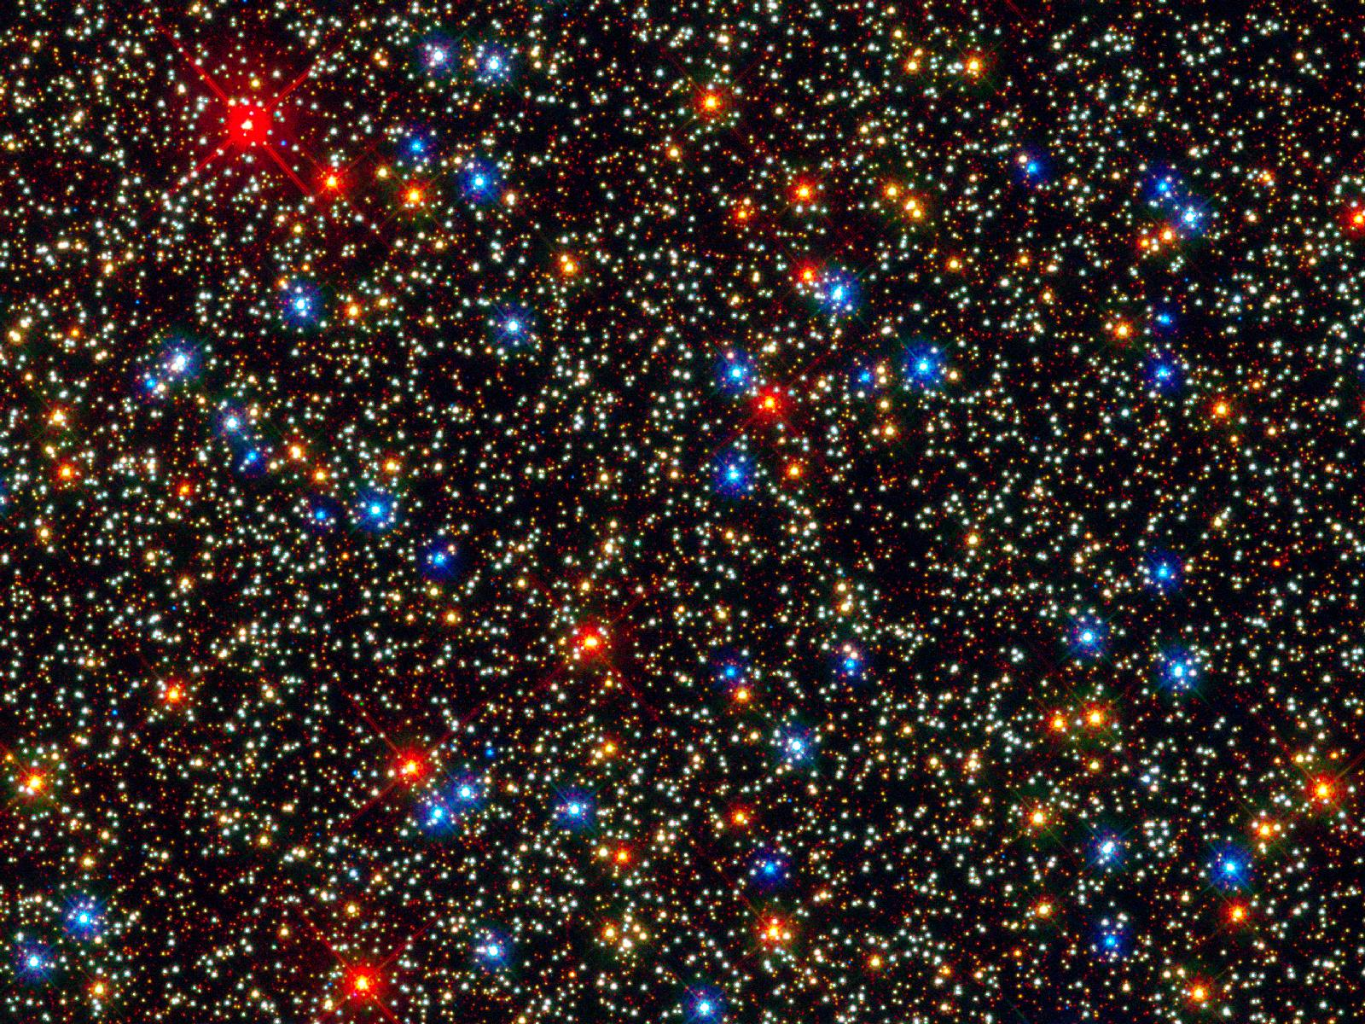
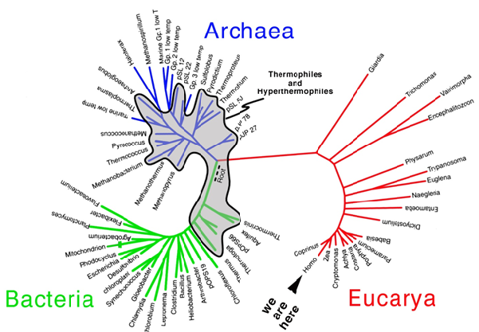
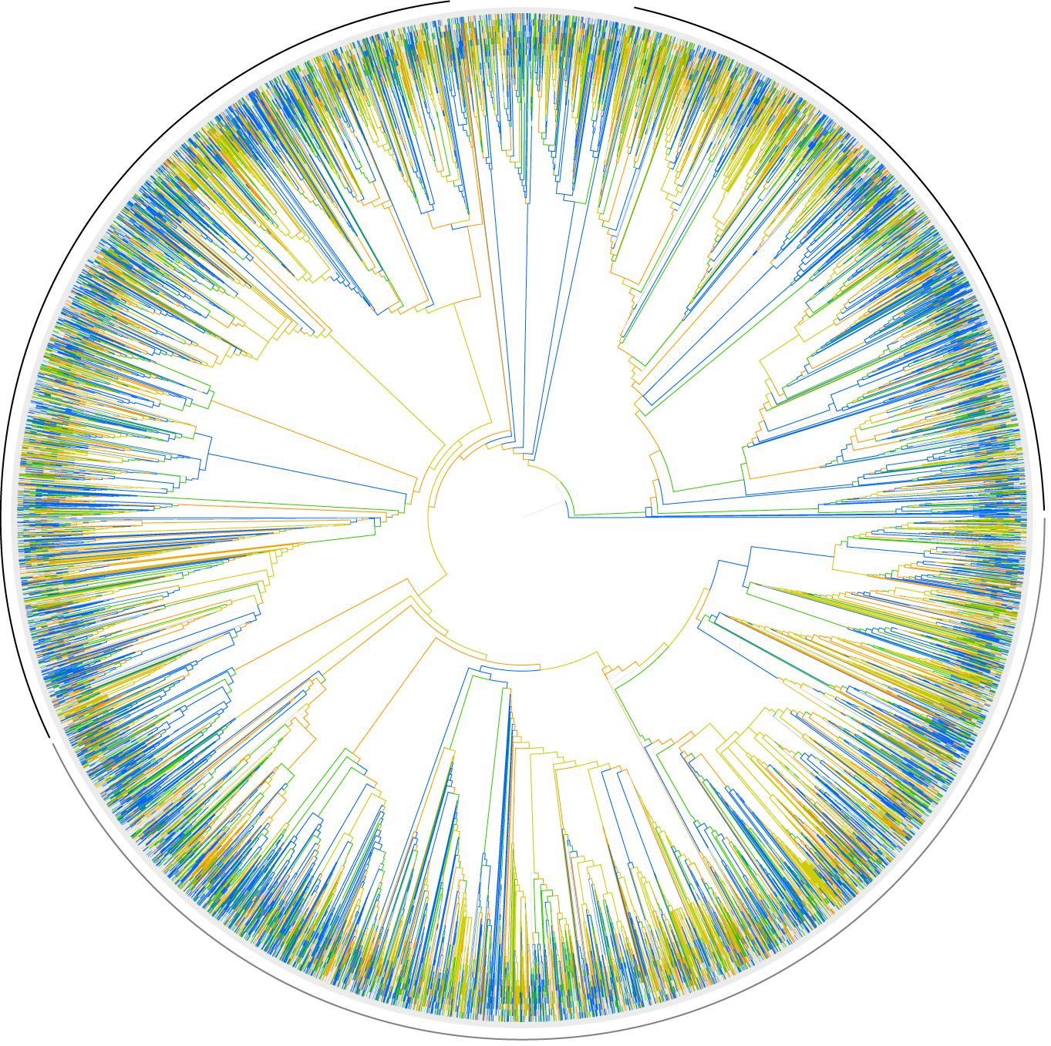
As sequence databases grow, our picture of the protein universe becomes more complete
1984 – 2,677 proteins
1998 – 60,000
2014 – 38,000,000
Why can't we find every homolog?

Slide 15
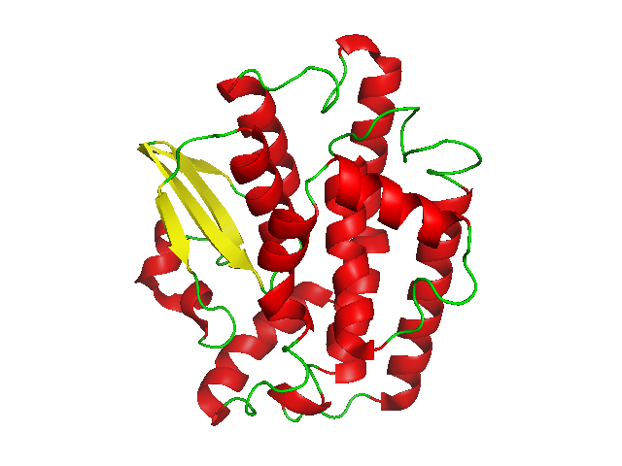
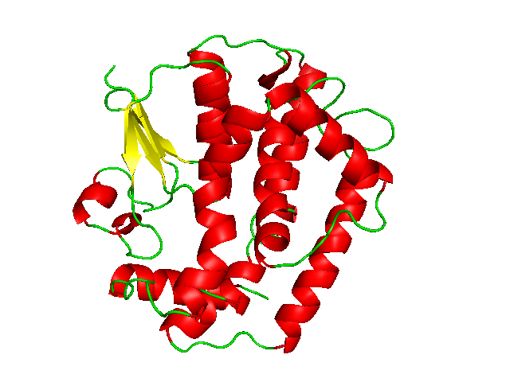
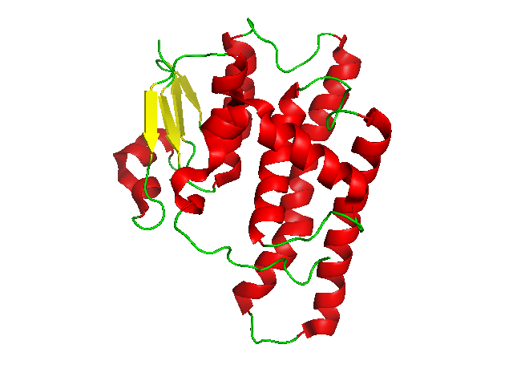
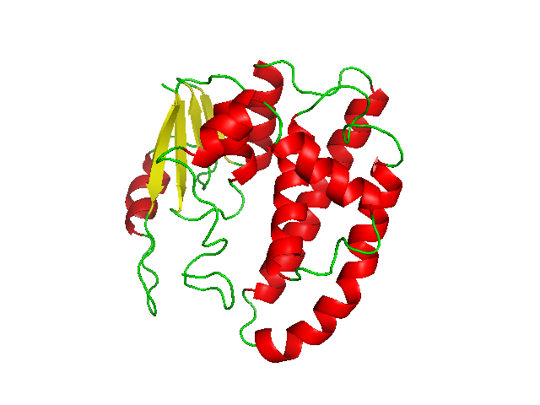
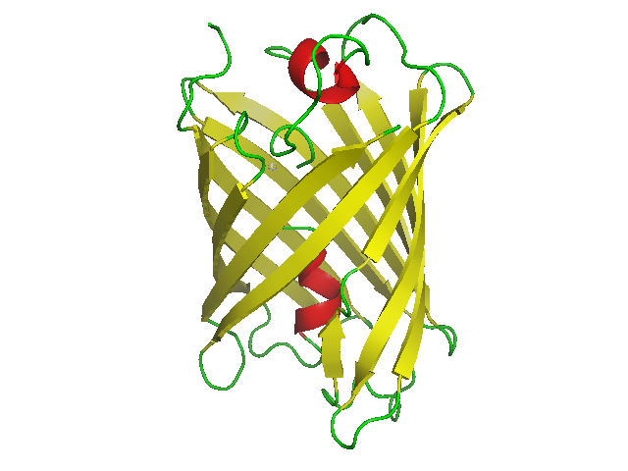
Many homologs are easy to find
2C3NA E(seq) < 10⁻¹¹¹
100% ident
1LJR E(seq) < 10⁻⁵⁰
54% ident
3QAV E(seq) < 10⁻⁸
24% ident
But some are as distant as non-homologs
6GSW E(seq) < 1.7
25% ident
2OTB E(seq) < 1.6
25% ident

Slide 16
Structure comparison is (still) more sensitive than sequence comparison
But structure comparison produces many more errors
Sierk and Pearson, 2004

Slide 17
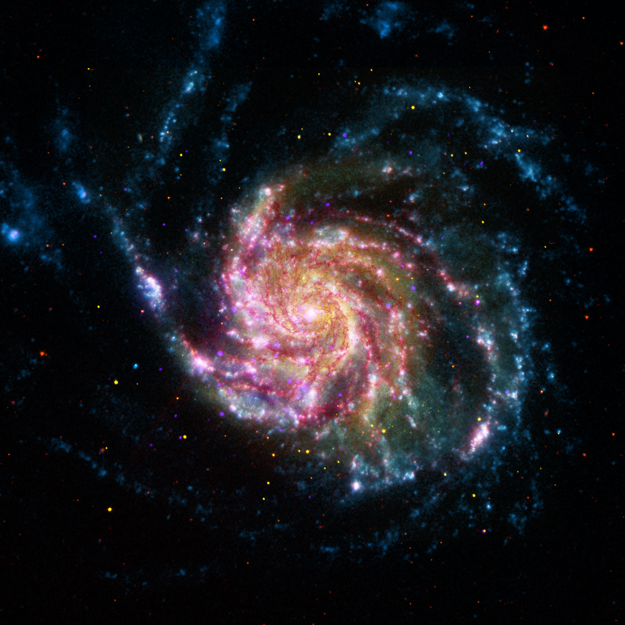
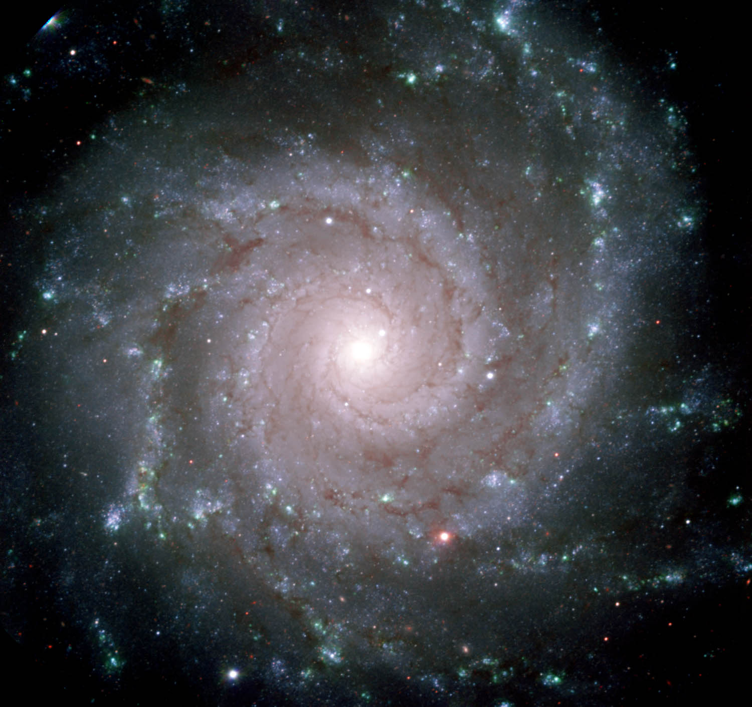
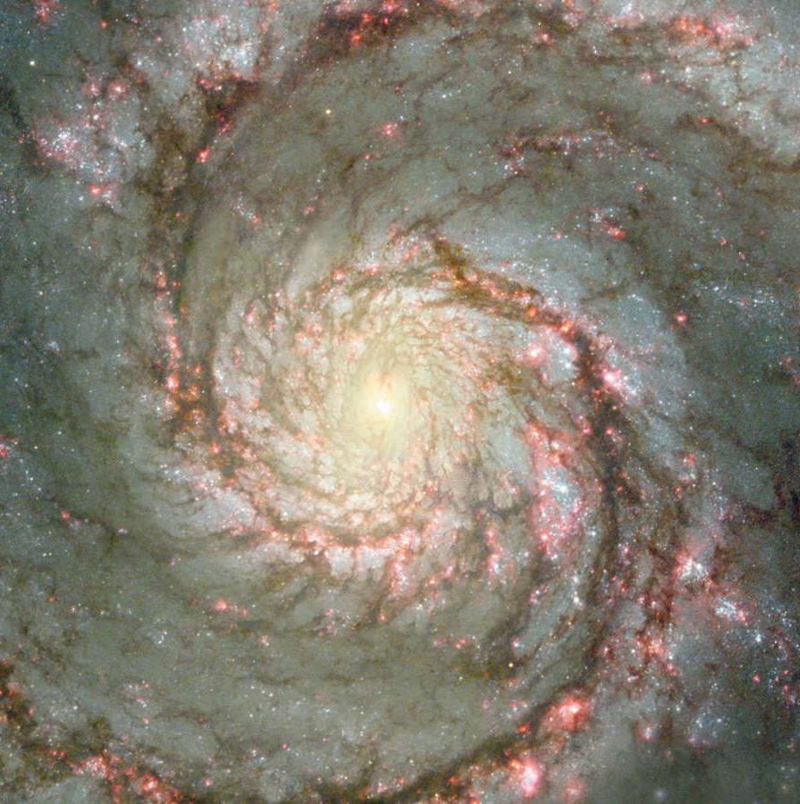
Why do sequences look similar? Why do structures look similar?
Nebulae look similar because they are shaped by universal physical laws

Slide 18
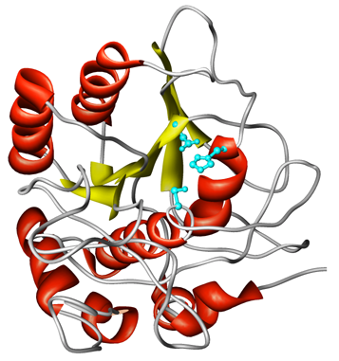
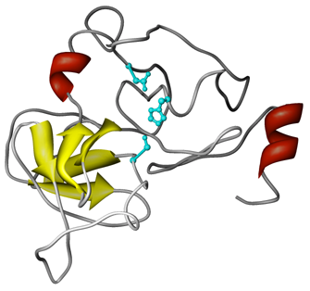
Proteins look similar when they share an ancestor
Bovine Trypsin
S. griseus Trypsin
S. griseus Protease A
Sometimes they are not very similar
Sometimes they are clearly different
Sierk and
Pearson, 2005
Viral Protease
Subtilisin

Slide 19
Ancient Relationships – Divergence vs Convergence
The evolutionary basis for structural/functional similarity is important
similarity because of history (homology, divergence) versus similarity because of physical or functional constraints (convergence)
we seek "universal laws" that allow us to make predictions – e.g. certain mutations always reduce activity
what if those the "laws" are family specific?
Function does not follow universal rules

Slide 20
Similarity (alone) produces poor function predictions
Schnoes, et al 2009
Skunca et al 2012

Slide 21
Inferring Function – Critical Information
Homologous proteins always have similar structures, but need not have similar functions
BLAST and FASTA obscure information required to infer function
Even with appropriate information, inferring function is challenging
Homology – E() value
Alignment location
Catalytic activity of homologs
State of active site residues
Currently, similarity searching programs focus on homology, and fail to present available functional annotation

Slide 22
Providing Functional Information
Holliday et al, 2012

Slide 23
Alignments with annotations

Slide 24
Function from Alignment Annotation
NCBI/Refseq, Uniprot, PDB, MACiE provide residue-level functional, and variant annotation
Only 33% of Macie functional annotations are annotated in Uniprot
Only ~2000/7399 human Uniprot proteins with an E.C. number have functional annotations
Annotations need to be merged/homogenized
Annotations need to be transferred to alignments

Slide 25
30+ years of similarity searching
Lessons – what have we learned?
Darwin was right (we're all related)
life has been complex for a very long time (almost since the beginning!!)
very few constraints on protein sequences
Challenges – what do we miss?
as protein space is sampled more densely, sequence comparison should become as sensitive as structure comparison (unless the building blocks are very small)
linking structure to function – by linking biology to alignments

